Slide 1


The Helgitas present
Helping Pro Juventute track impact and change lives
Notes:
Hi Everyone,
My name is Petra Ribiczey Rüegger, I am the PM of KPI app team: The Helgitas.
Today, with Monica and Soraia, we are going to present you the Impact Tracker.
But first, meet The Helgitas...

Slide 2











Our team
The Helguitas
PM
Scrum Master
UX/UI Lead
Fullstack Lead
Petra Ribiczey-Rüegger
Amélie Renard
Jara Belmonte
Nurpinar de Kloet
Frontend Lead
Backend Lead
Data Lead
Missing
Monica Chmilevski
Soraia Tavares
Clive Ulyate
Notes:
Who are we?
End: What is our challenge?

Slide 3





Help
With their kpi process
Notes:
We have a task to help Pro Juventute to optimize their KPI management.
For those of you who don't know, Pro Juventute is a Swiss charitable organization helping children and young people in Switzerland.

Slide 4

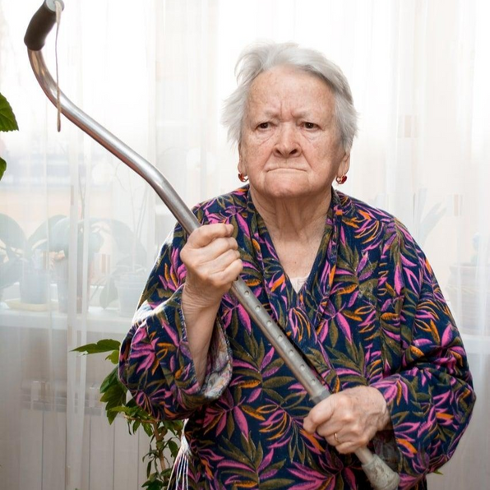


Our target users
Helga, “Gatekeeper”
Data Manager
Gita, “Economist”
KPI Owner in a team
Notes:
We did the project with 2 target groups in mind:
- The Data Manager, Helga, the "Gatekeeper" here
- the Pro Juventute team "Economists", KPI owners, represented by Gita
Helga, the Gatekeeper, is super tech-savvy. She will be the administrator of our app: she will set up the KPIs and will maintain the system.
Gita is the typical team Economist, she is the one updating team KPIs with new values regularly. She isn't tech savvy, and often gets confused by technical tasks.
So we built the app with her in mind.

Slide 5



Problems with KPI data collection
Involves a huge Excel sheet where all teams collect all their KPIs.
People add, edit, and accidentally remove full rows, move cells, etc.
Notes:
Problems start at the data collection as Pro Juventute uses one big Excel sheet for this task.
Just imagine, you as an Ecomonist, want to add fresh data to the KPI tracking sheet. You sit down, open this huuuge excel sheet, only to find that somebody has deleted your previous rows, and then the new cell is blocked, you don't know what to do... you feel quite frustrated and annoyed.
And this happens regurarly.
So you see, in the current process, adding new KPI values is cumbersome, there are lots of errors, data can get lost.
Excel wasn't built to be used this way, especially not by people who aren't tech-savvy.
[End with:]
So, with this in mind,

Slide 6

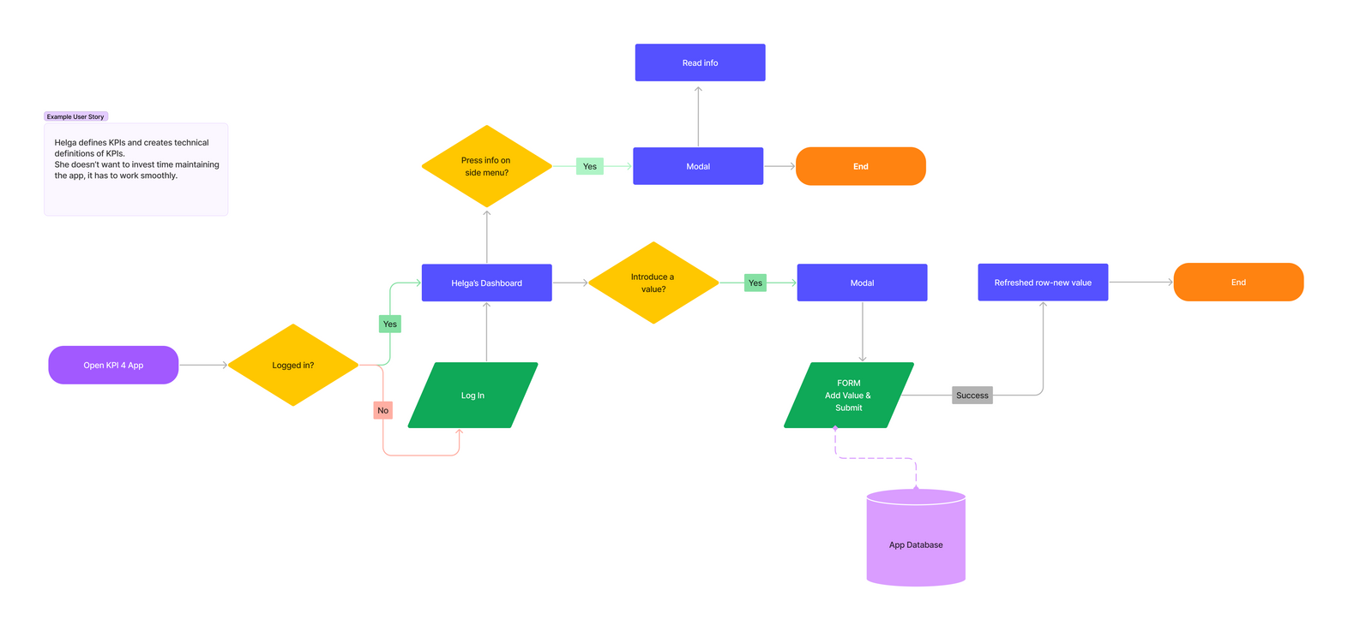
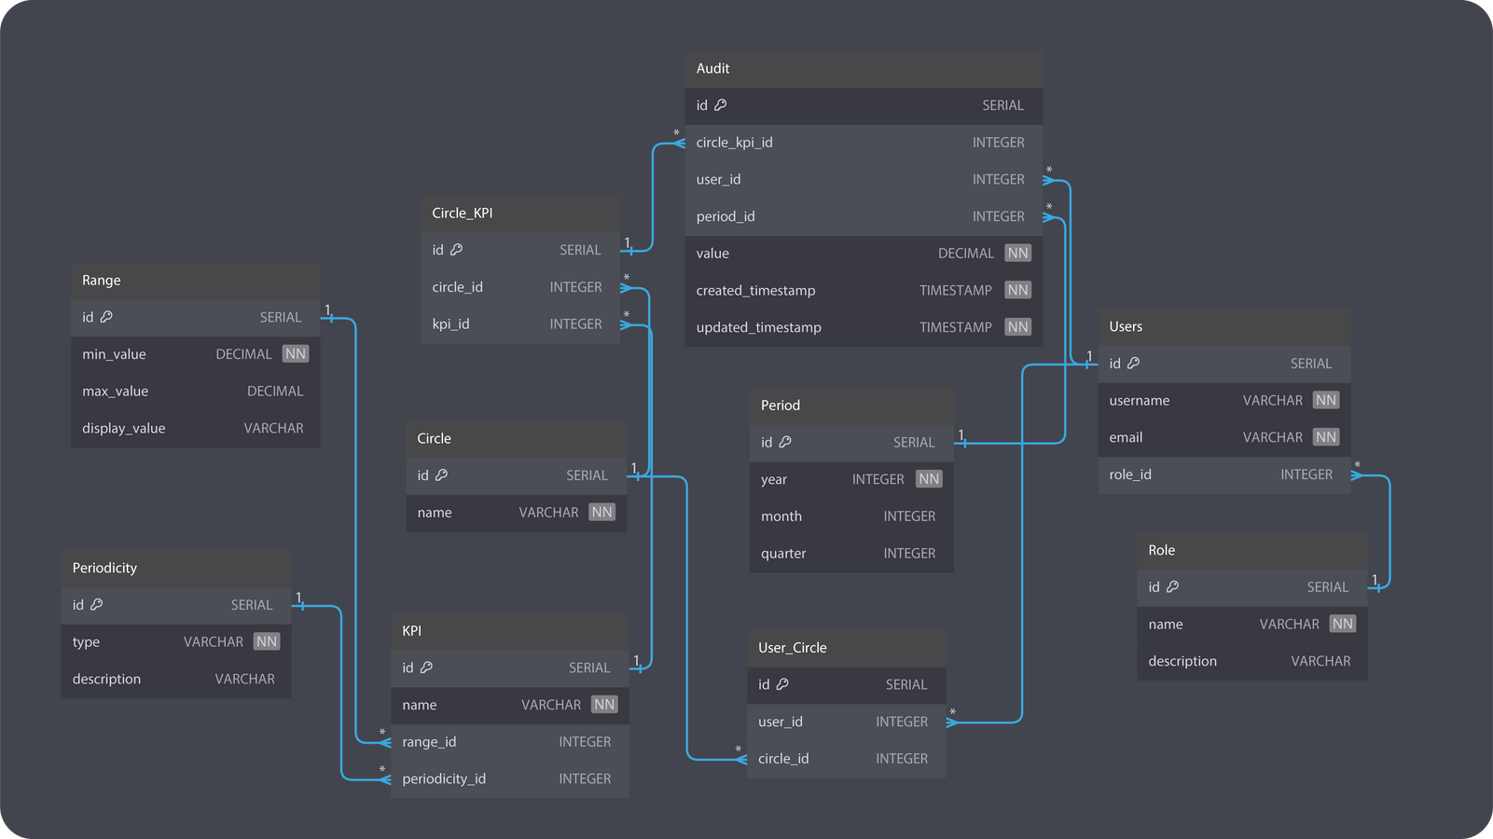

Our focus to date
Our MVP
makes it easy to manage KPIs, with focus on making the addition of new values intuitive and error-proof, designed to assist color-blind users as well.
with flexible architecture and ER model that can scale and be integrated
Notes:
We created a simple and easy-to-use MVP.
We said that it's the Economist who needs help most.
SLIDE
And now Soraia and Monica, fellow Helgitas, are going to demo Impact Tracker.

Slide 7
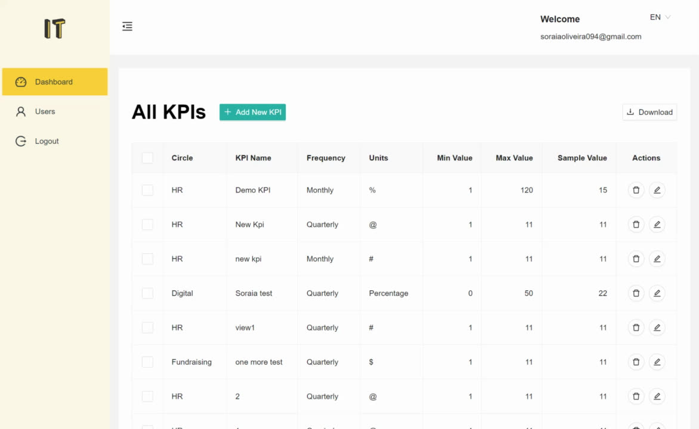
Notes:
[Soraia]
Impact Tracker is a web app offering a simple, stress-free alternative to the current KPI tracking process.
- We have separate workflows and dashboards for the Gatekeeper and the Economists.
- The access is role-based following our RLS implementation.
Let's start with the Gatekeeper:
- In the "Users" tab, the GK is able to modify the app's users role and, in the future, add and delete users.
Moving to the Dashboard tab:
- Right out the bat, the GK has a list of all the KPIs he created.
- Setting up a new KPI takes less than a minute.
- The same goes for editing and, of course, deleting a KPI.
[Monica]
Let's continue with the Economist's dashboard:
- The Economist sees only her own team's KPIs, with a separate table to show the items that need a new value
- After 2 simple clicks, they can enter new KPI values using this simple form.
- In case of an incorrect entry, an error message guides the Economist to correct the input. This is the automatic validation of the value.
- Once the value is correct, a request for a quick confirmation pops up, to make sure really all is good.
- After submission to the database, the KPI value appears in a separate table, for downloading, and we can also visualize the KPI development easily.
For viewing all Pro Juventute's past and present KPIs, there is a separate table reachable from the side bar.
Intuitive, isn't it?

Slide 8
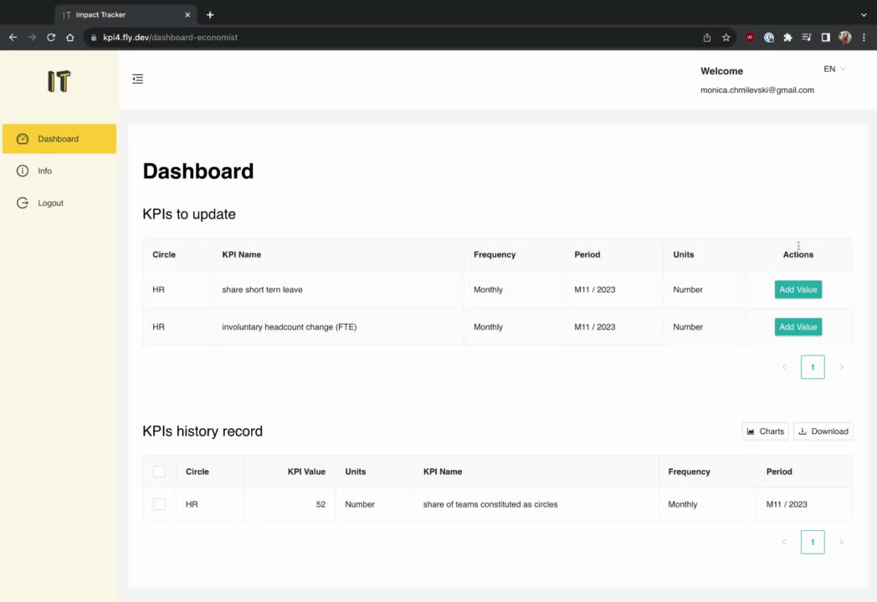

Slide 9













What is in the background?
Notes:
From a technical perspective, Impact Tracker
is a single-page application (SPA)
- Uses Supabase with integrated database and REST APIs and SSO
- Runs on Fly.io
- For visualization we have integrated with Tableau
[End with:]
We designed a couple of features for the future as well, that I'd like to share with you.

Slide 10

Future features
For the Economist:
The app will be multilingual
New KPI request form can be filled in and sent to Gatekeeper
Request access on the Login page
For the Gatekeeper:
User administration on Gatekeeper dashboard
Notes:
- In the future, users will be able to choose their preferred language in the platform after it's been localized
- Economists will be able to request the setting up of new KPIs in the app.
- New economists will be able to ask for access from the Login page
- And the Gatekeeper will be able to fully manage all users from the dashboard.

Slide 11
What did we learn during product development?
How to adapt to compensate for a missing developer.
How to go from an idea to an actual product.
Supabase and fly.io are so easy and nice platforms to help bring an idea to life very fast.
GitHub Actions simplifies and speeds up CI/CD implementation.
Notes:
And now a couple of learning points....
It has been a delightful experience!
We learned how to adapt to compensate for the one missing developer as we focused on the skills we had.
We learned how to build a product from an idea.
We learned to use great platforms and tools, like Supabase and fly.io that women++ have introduced to us.
[End with]
Thank you very much!
We are ready to answer your questions.

Slide 12

QUESTIONS?

Slide 13


Reach out to us on LinkedIn
Amélie Renard, Scrum Master: amelie-renard
Clive Ulyate, Data Lead: cliveulyate
Jara Belmonte, UX/UI: jarabelmonte
Monica Chmilevski, Frontend: monica-chmilevski
Nurpinar de Kloet, Full stack: Nurpinar
Petra Ribiczey-Rüegger, PM: petra-ribiczey-ruegger
Soraia Tavares, Backend: soraiatavares094

Slide 14


THANKS!
Notes:
Thank you for your attention.

